Slide 1



Slide 2



01CE0503 - Design and Analysis of Algorithm
Unit - 6
Graph Algorithms
Prof. Jaydeep K. Ratanpara
Computer Engineering Department

Slide 3



OUTLINE
Introduction
Representation of Undirected & Directed Graph
Traversing Graphs
Depth First Search
Breath First Search
Topological sort
Strongly Connected components
Single Pair Shortest Path
Minimum Spanning trees (Kruskal’s algorithm, Prim’s algorithm) using greedy approach,
All Points Shortest path using Dynamic Programming

Slide 4
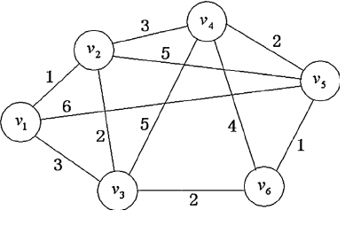
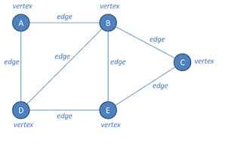
INTRODUCTION
Graph: A Graph is a non-linear data structure consisting of vertices and edges. The vertices are sometimes also referred to as nodes and the edges are lines or arcs that connect any two nodes in the graph. More formally a Graph is composed of a set of vertices( V ) and a set of edges( E ). The graph is denoted by G(E, V).

Slide 5
INTRODUCTION
Applications of Graph
Used to determine the shortest paths.
Used by search engine crawlers to build indexes of web pages.
Used to find available neighbour nodes in peer-to-peer networks such as BitTorrent.
Used to find locations and routes in GPS. (Graphs are used in Google maps to find the shortest route.)
Graphs are used in social networking sites where users act as nodes and connection between them acts as edges.

Slide 6
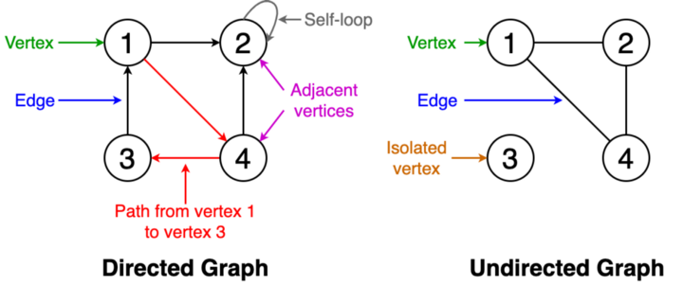
Representation of Undirected & Directed Graph

Slide 7
Representation of Undirected & Directed Graph
Important Definitions
Adjacent Vertices : Two vertices are said to be adjacent if they are connected to each other by the same edge.
Order or graph: The number of vertices in the graph
Size of graph: The number of edges in the graph
Vertex degree: The number of edges that are incident to a vertex
Isolated vertex: A vertex that is not connected to any other vertices in the graph

Slide 8
Representation of Undirected & Directed Graph
Important Definitions
Self-loop: An edge from a vertex to itself.
Directed graph: A graph where all the edges have a direction indicating what is the start vertex and what is the end vertex.
Undirected graph: A graph with edges that have no direction. Here edges are not ordered.
Weighted graph: Edges of the graph has weights
Unweighted graph: Edges of the graph has no weights

Slide 9
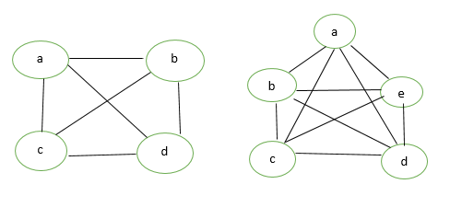
Representation of Undirected & Directed Graph
Important Definitions
Complete Graph : A graph with n vertices is called a complete graph if the degree of each vertex is n-1, that is, every vertex is attached with rest of the vertices in the graph. A complete graph is also called Full Graph. Total edges = (n*(n-1))/2

Slide 10
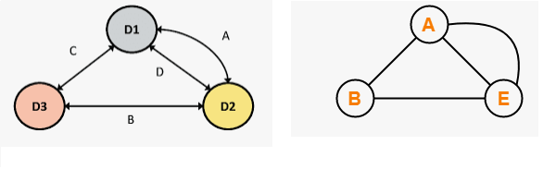
Representation of Undirected & Directed Graph
Important Definitions
Multi Graph : Any graph which contains some parallel edges but doesn’t contain any self-loop is called a Multi graph.
Parallel Edges: If two vertices are connected with more than one edge then such edges are called parallel edges that are many routes but one destination.

Slide 11
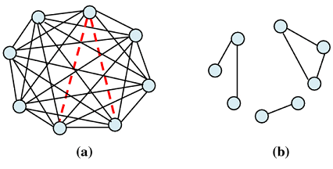
Representation of Undirected & Directed Graph
Important Definitions
Dense Graph : The graph which contains maximum number of edges for connecting vertices of a graph is called dense graph.
Sparse Graph: The sparse is a kind of graph having minimum number of edges within it.

Slide 12
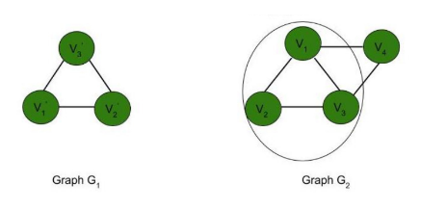
Representation of Undirected & Directed Graph
Important Definitions
Sub Graph : A graph G1 = (V1, E1) is called a subgraph of a graph G(V, E) if V1(G) is a subset of V(G) and E1(G) is a subset of E(G) such that each edge of G1 has same end vertices as in G.

Slide 13
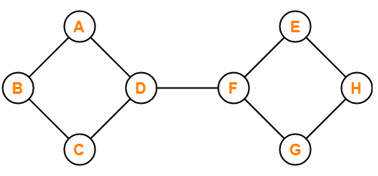
Representation of Undirected & Directed Graph
Important Definitions
Connected Graph : A graph in which we can visit from any one vertex to any other vertex is called as a connected graph.
In connected graph, at least one path exists between every pair of vertices.

Slide 14
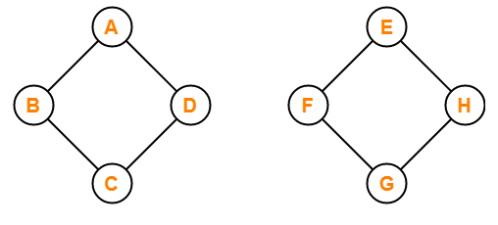
Representation of Undirected & Directed Graph
Important Definitions
DisConnected Graph : A graph in which there does not exist any path between at least one pair of vertices is called as a disconnected graph.

Slide 15
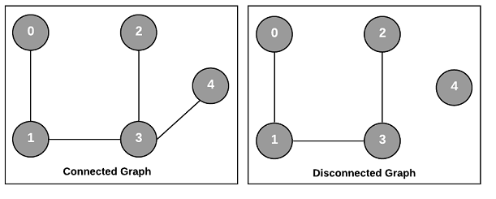
Representation of Undirected & Directed Graph

